Slide 1

Understanding Traffic
Anvita Nagireddi, Jenna Odom, Rankin Odister, Vaish Pulla

Slide 2

AGENDA
Overview of the dataset
Exploratory analysis
Evaluation metrics
K Nearest Neighbors
Multiple Regression Models
Arima Model

Slide 3
Traffic Dataset
Traffic Prediction Data Set
Columns:
Potential Uses: transportation planning, congestion management, and traffic flow analysis.
Important Notes: Traffic often changes based on the time of day on a specific day of the week. Thus, for this reason some form of categorization of the data may be beneficial.
Kaggle description:

Slide 4
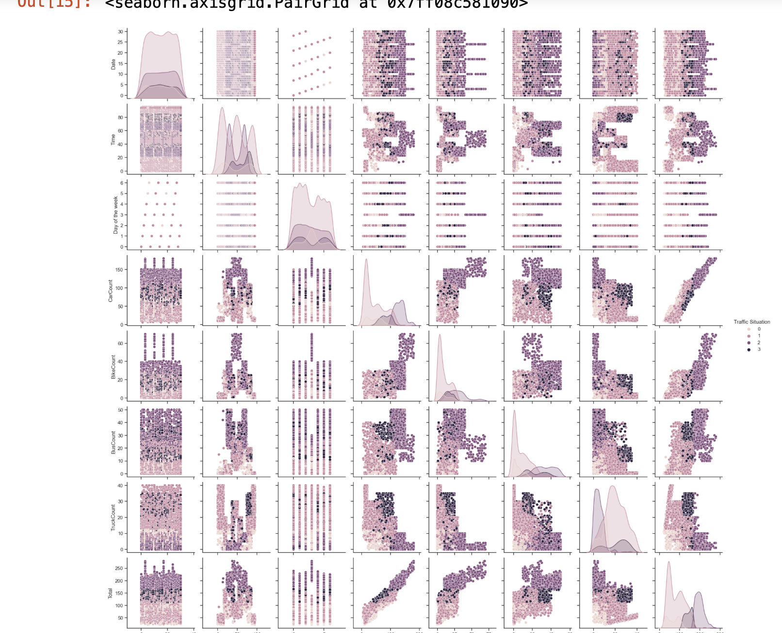
Exploratory Data Analysis
Covariance
Correlation
Mean
Median
Standard deviation

Slide 5
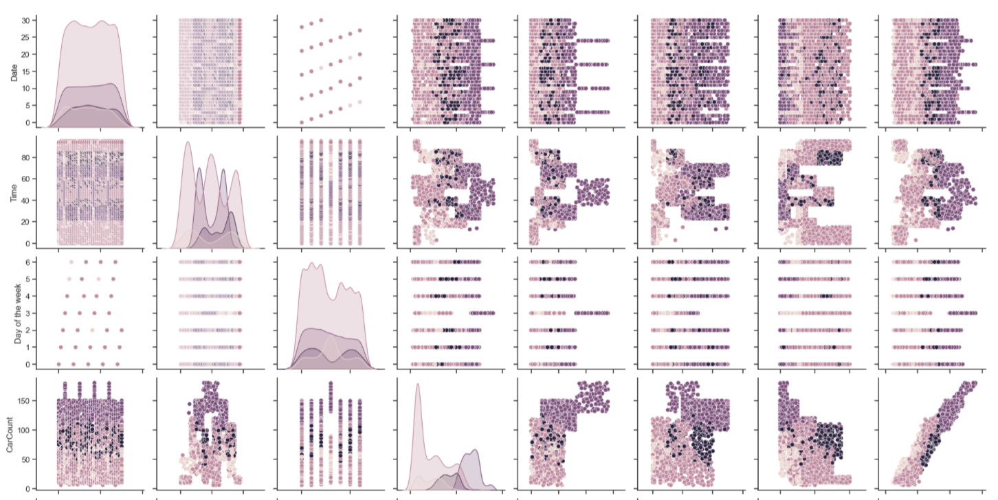
Exploratory Data Analysis
Correlation (Continued)
Time variables
Clear Correlation between variables that are related to time with regards to how it impacts traffic situation.
Indicates that the time feature may be of importance considering different models

Slide 6

K Nearest Neighbors

Slide 7
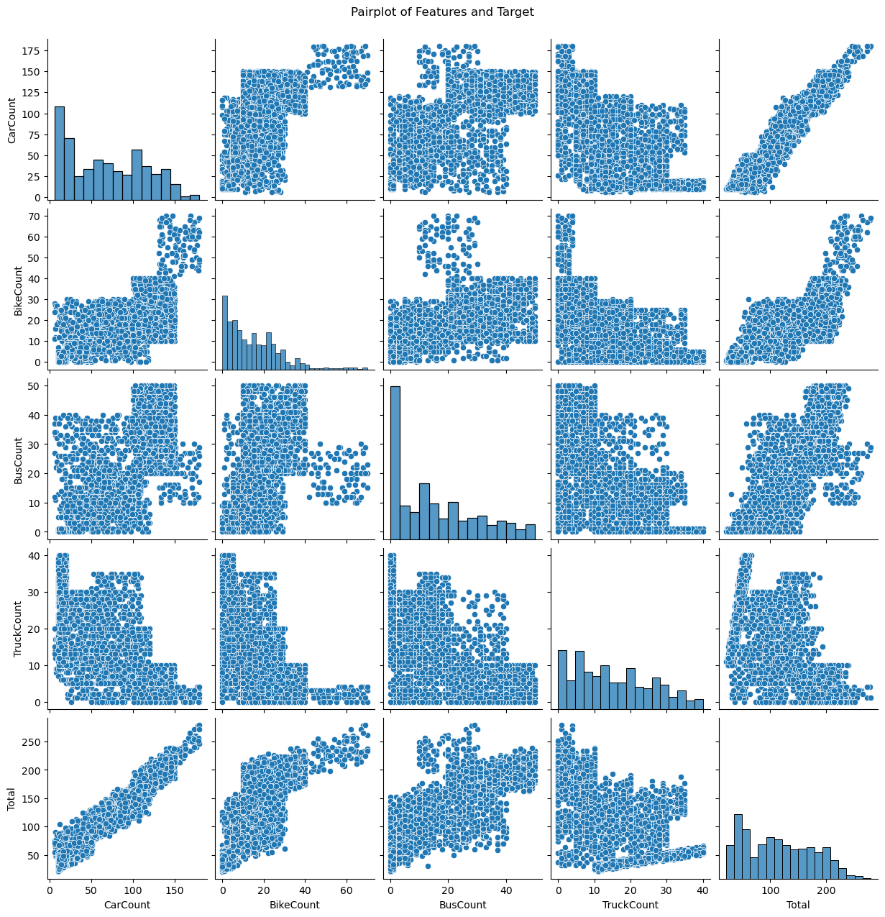
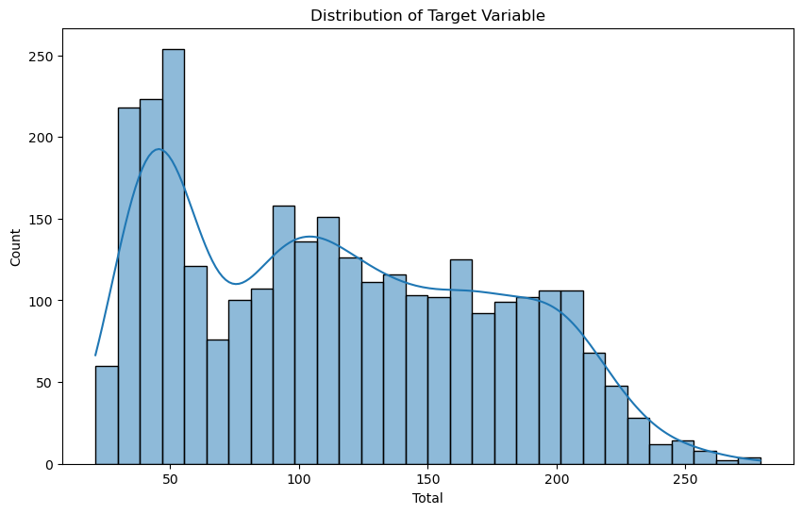
Pairplot: Explored pairwise relationships among features and the target variable ('Total').
Distribution Plot: Examined the distribution of the target variable.

Slide 8
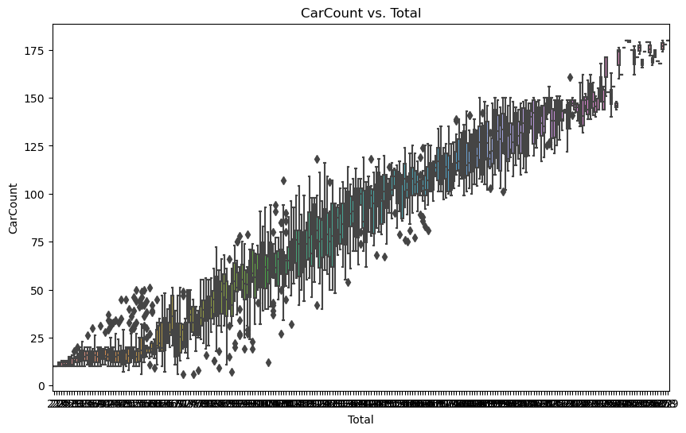
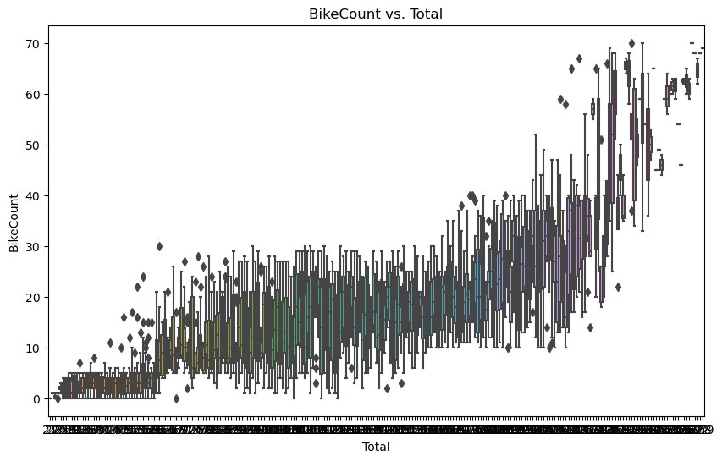
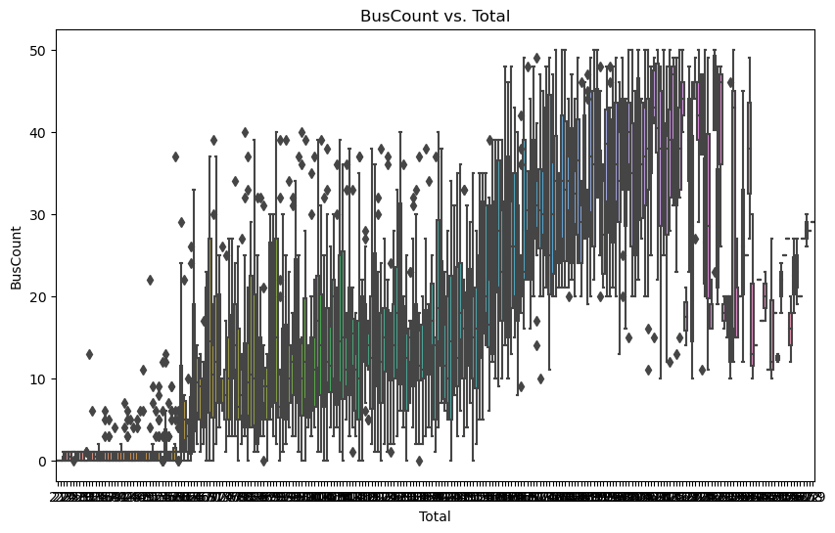
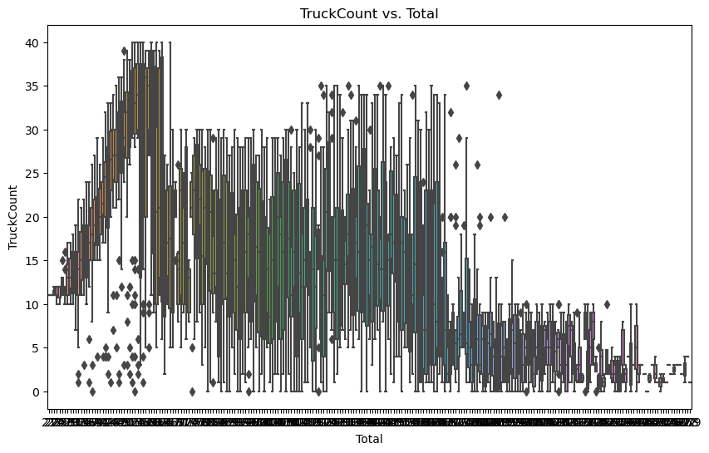
Count Plots: Displayed the count of observations for each 'Traffic Situation'.

Slide 9
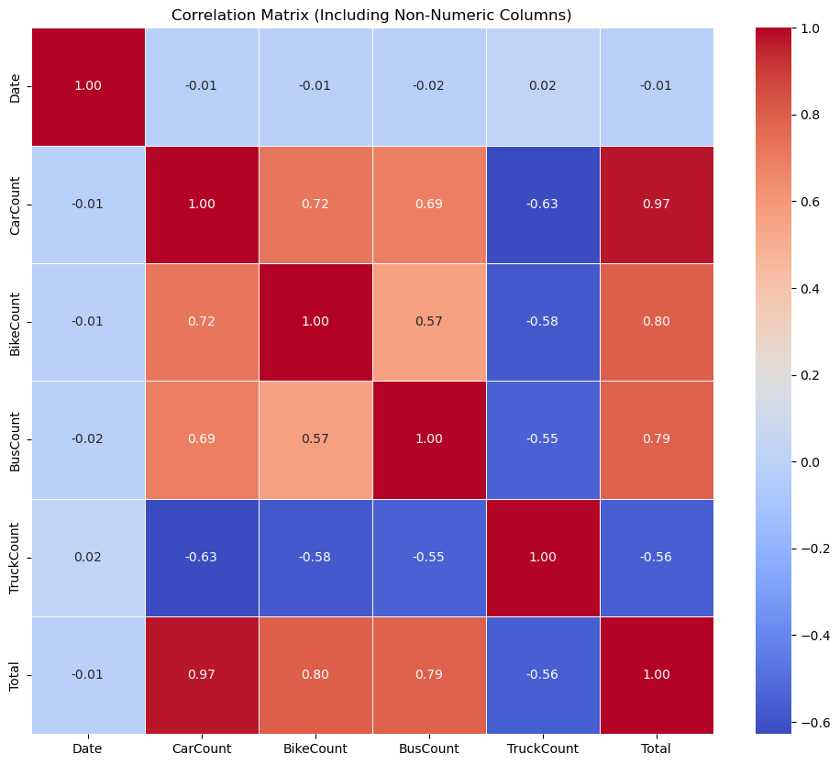
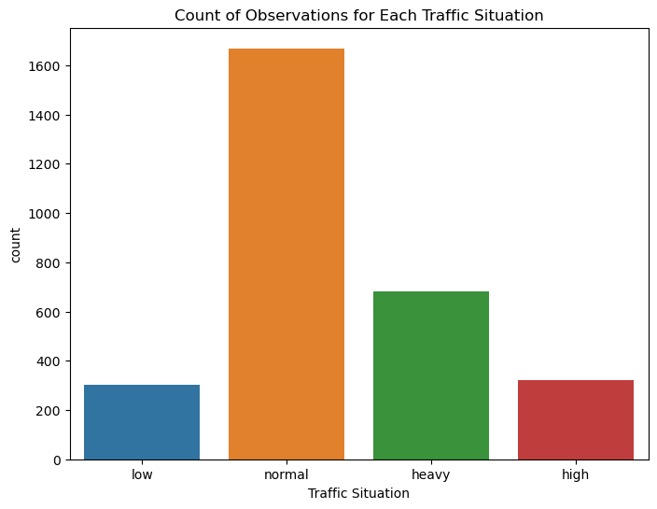
Correlation Heatmap: Visualized correlations among numeric columns, including non-numeric ones.
Box Plots: Investigated the relationship between each feature and the target variable.

Slide 10
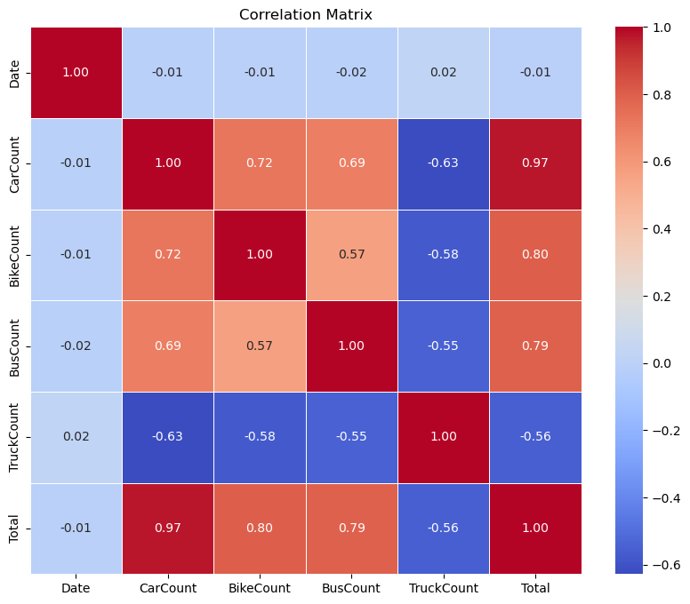
Made predictions on both the training and testing sets.
Calculated R2 Scores for training and testing to evaluate model performance. (Training R2 Score: 0.9985725315666825 Testing R2 Score: 0.9977704145531208)
Displayed the evaluation metrics, showing the goodness of fit of the model.
Computed and visualized the correlation matrix.
Visualized the covariance matrix.
Analyzed relationships and patterns among variables

Slide 11

Multiple Regression Models
Linear, Quadratic, Cubic
Comparing count of automobile types on road vs. traffic situation
In the creation of these models, time was held constant which may explain poor fit.

Slide 12
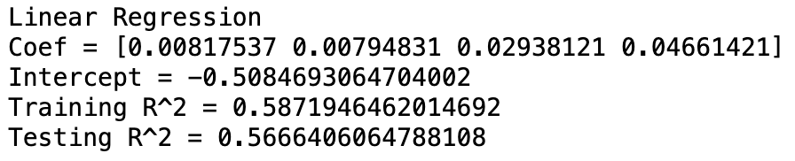
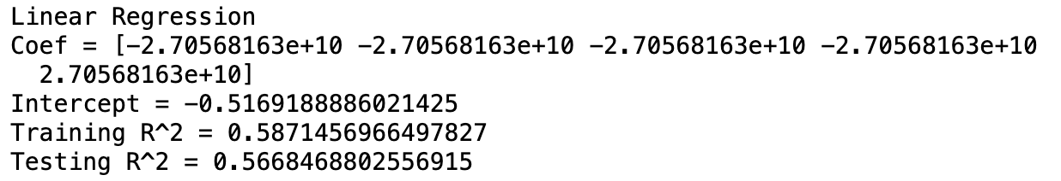
Linear Regression
Coefficient indicates that 'CarCount', 'BikeCount', 'BusCount', 'TruckCount' all have an impact upon the Y-variable (‘Traffic Situation’), but BusCount' and 'TruckCount' have a significantly larger impact per unit on the road in relation to the Traffic Variable
R^2 Values indicate that only a little over half of the x-variables’ variation is captured by the model, in either training or testing format

Slide 13
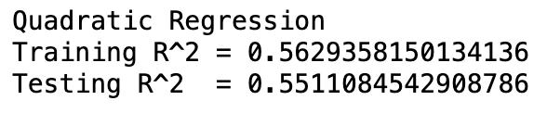
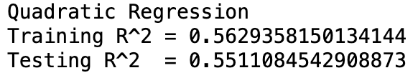
Quadratic Regression
R^2 Values indicate that only a little over half of the x-variables’ variation is captured by the model, in either training or testing format
This is very close to the previous model’s, but it is minutely lesser in capturing the variation of the X-variables.

Slide 14
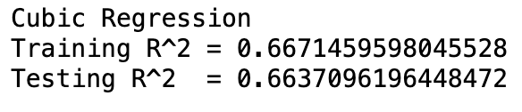
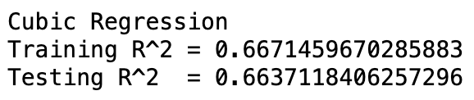
Cubic Regression
R^2 Values indicate that only a little over two-thirds of the x-variables’ variation is captured by the model, in either training or testing format.
This is definitely better than the previous two regression models.

Slide 15


ARIMA Model
Autoregressive integrated moving average (ARIMA)
It has been historically used to predict traffic
Uses times series past values to predict future values

Slide 16

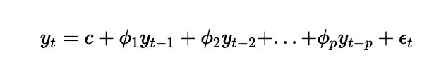

ARIMA (p,d,q)
AR (Auto Regressive) - model linearly regressed on its own past values
allows for the consideration of seasons (week to week)
I (Integrated) - considers the difference between each time period
MA (Moving Average): Considers the errors from previous prediction errors
Notes:
This is from ARIMA definition

Slide 17
ARIMA (p,d,q)
pmdarima package
Coefficient of determination is not appropriate because it is a time series.
used stepwise function to optimize pdq and minimize AIC
seasonality measured into the model
To interpret the effectiveness - used the AIC - Akaike Information Criterion
Notes:
This is from ARIMA definition

Slide 18
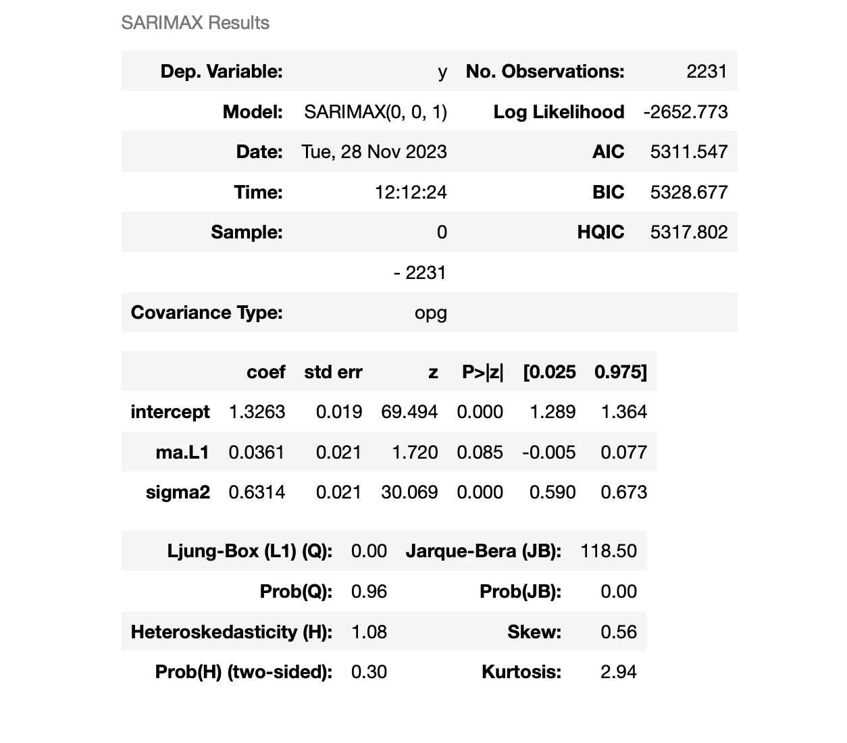
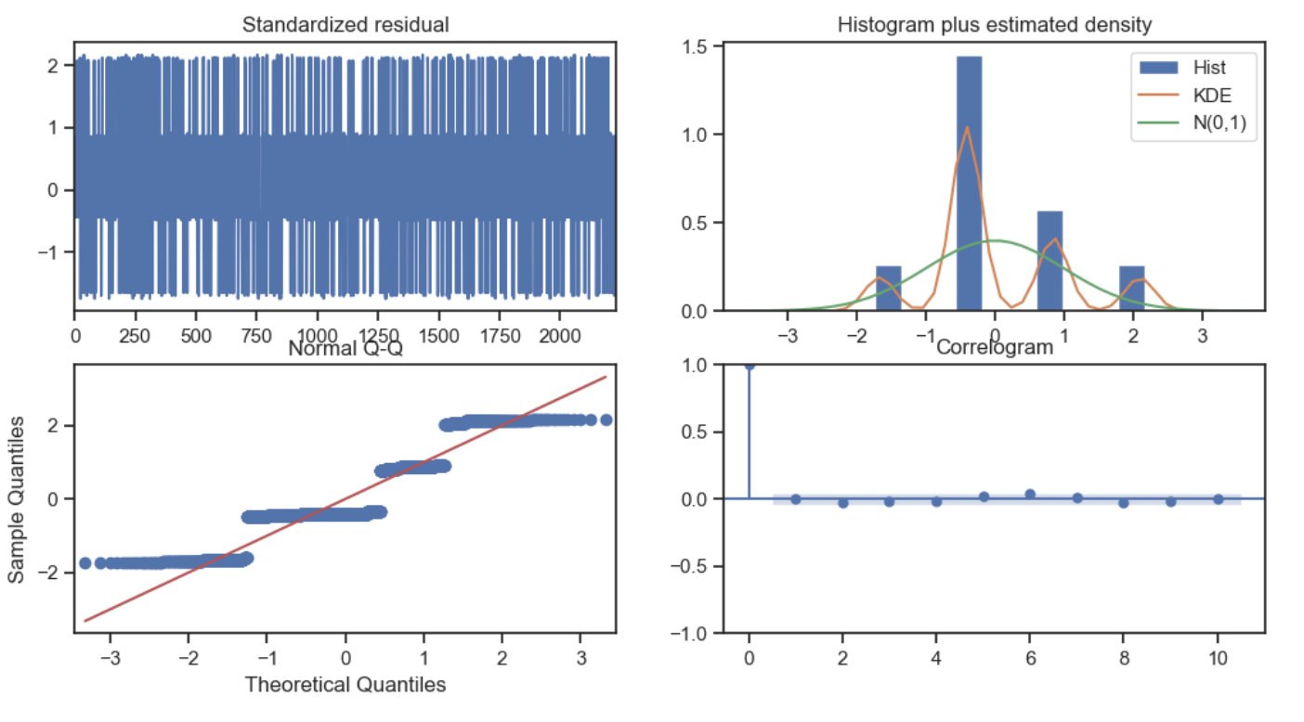
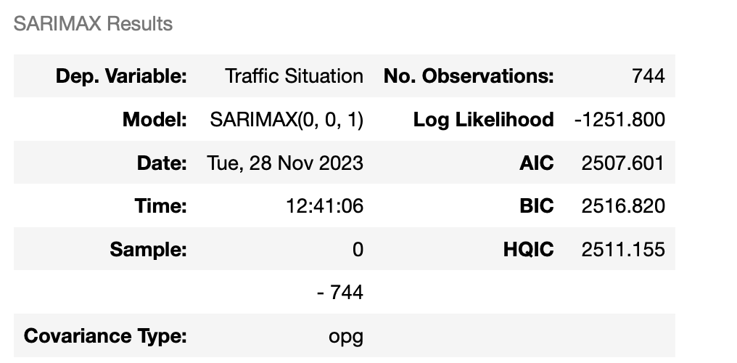
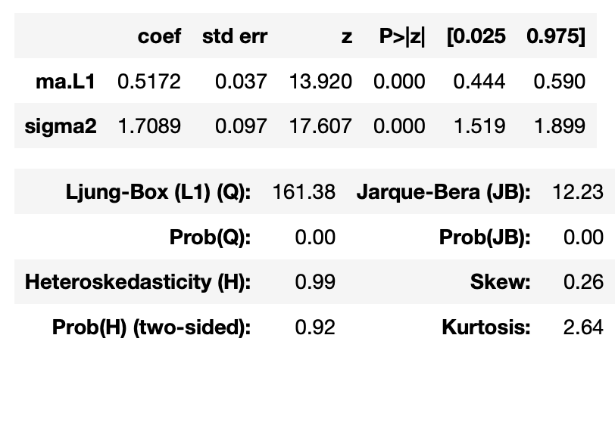
Training
Summary of ARIMA Model
Testing
Training AIC: 5311.547
Testing AIC: 2516.820

Slide 19
ARIMA
Notes about this model
It seems to be a poor fit to the model as it is arrange right now as the Q-Q Norm Plot is not linear.
Further improvements to the way seasonality is measured within the model may be beneficial.
Currently with the way the model is fit it doesn’t predict future data effectively.
Notes:
This is from ARIMA definition

Slide 20
Conclusion
In conclusion the model with the best fit was the KNeighbors model was the best fit based on our decided measurement of fit, however the AIC and BIC on ARIMA model indicate that it could be advantageous as well if adapted to better account for seasonality.

Slide 21

Thank you!
See you again soon!

